Slide 1

Array Basics in C++
By Varun Bansal

Slide 2

What and Why Variables

Slide 3


Let’s say we have to use a value again and again.

Slide 4
Basic Solution :
Use that value itself (567) again and again wherever it is required.

Slide 5

Problems. ??

Slide 6

Not a good idea
Not very fast
We are not using our machines efficiently
If Value is changed, we need to change at all the Places.
Very Tedious

Slide 7

Solution
Declare a variable and use that wherever the value is required.
If Value of a particular field is changed just change the value at one place.

Slide 8

Arrays

Slide 9

Suppose the teacher wants to store the names of 100 Students.
Should she declare 100 variables??

Slide 10

Obviously No
Too time taking
Not a practical solution
What if count is in Millions.

Slide 11

Time Taking

Slide 12
Practical Solution
We must have some kind of mechanism where we need not to initialize the variables again and again.
Here Array comes into the Picture .

Slide 13
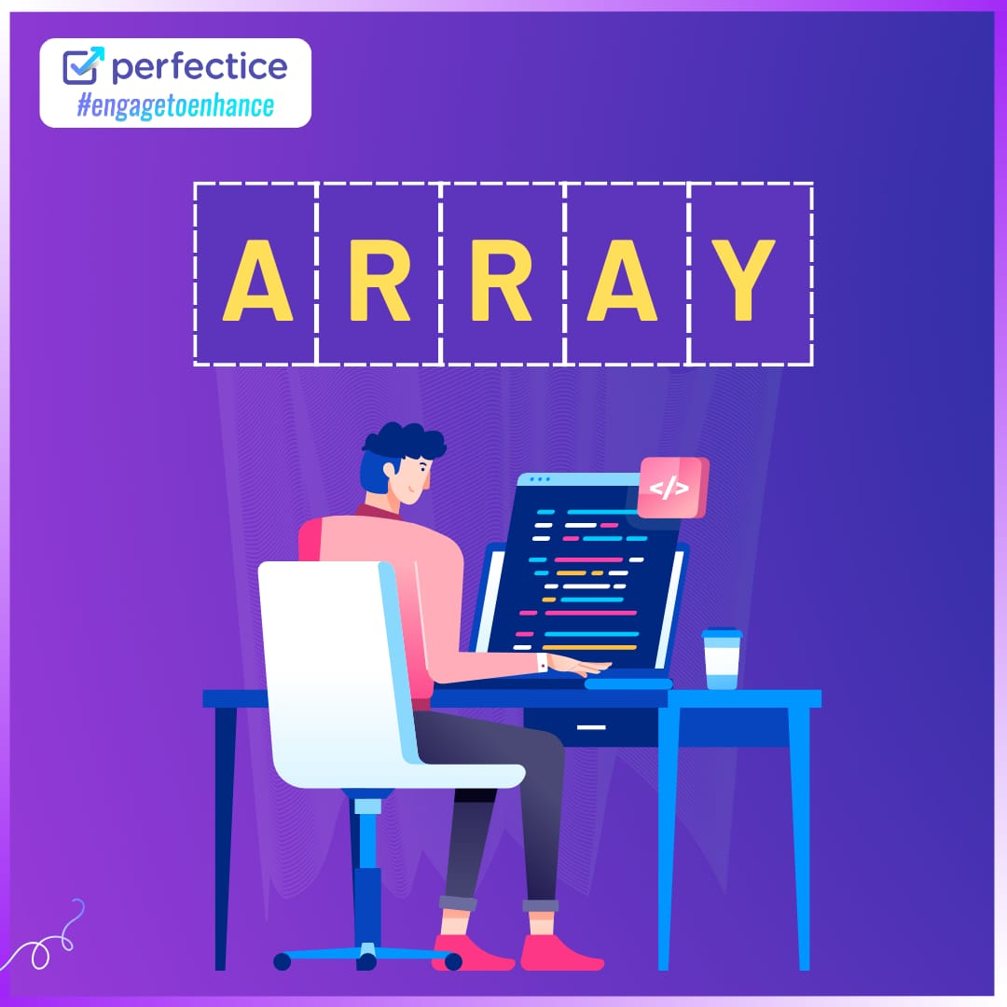

Slide 14
What exactly are Array?
How are they useful to us,
Come On Let’s Learn more about them.

Slide 15
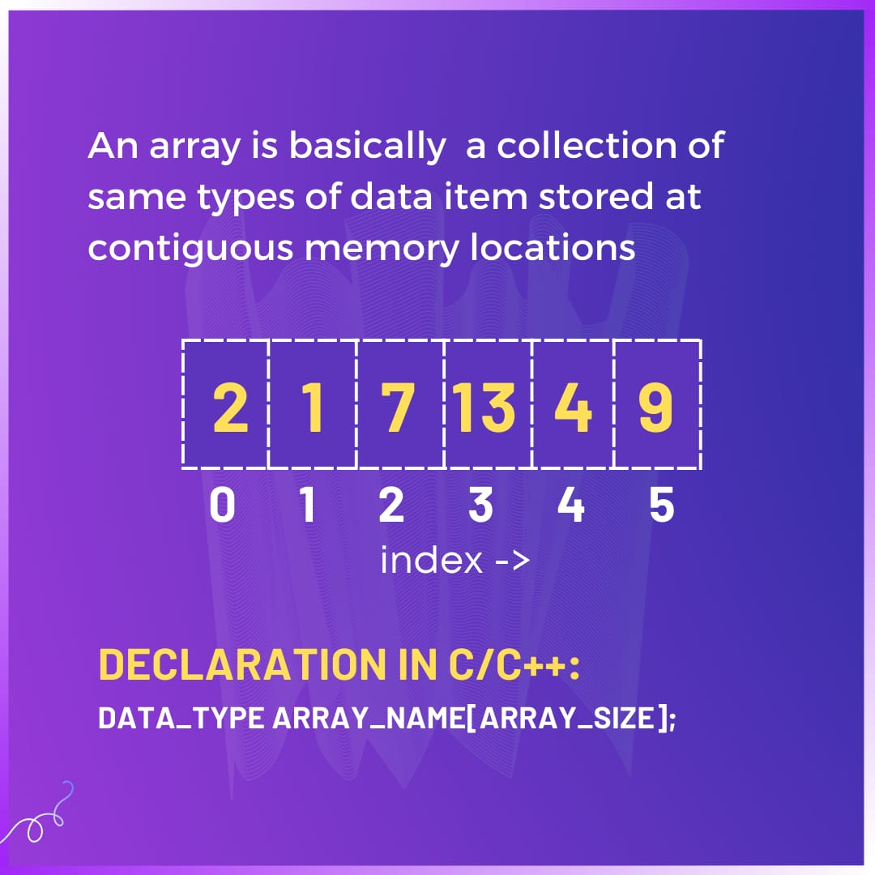

Slide 16
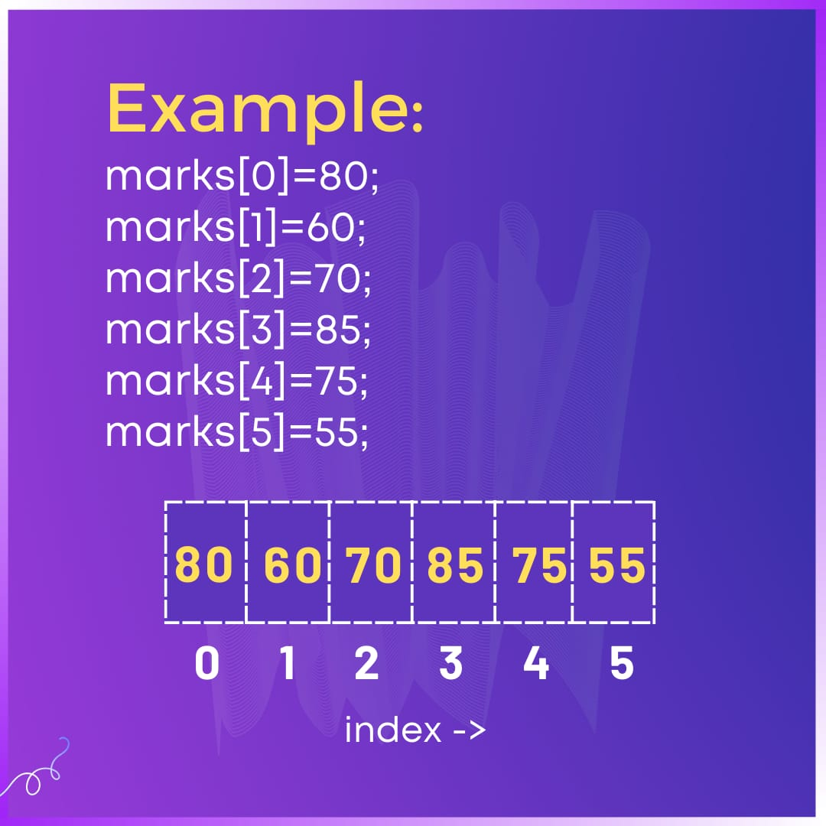

Slide 17

Let’s Jump to coding !
You can use any of the Compiler
CodeBlocks
DevC++
Vscode
Online compiler

Slide 18
Basic Codes
Taking the input from user and storing in the Array.
Displaying the values stored in Array.
To access the PPT and Codes: https://bit.ly/GFG-VB

Slide 19

Day 2

Slide 20

Coding Time
Let’s practice some Questions Today

Slide 21
Practice questions
1).Finding the MAX and MIN Element in the Array.
2)Reverse the Array
3.)https://leetcode.com/problems/running-sum-of-1d-array/
Finding the running sum of array.
4) https://leetcode.com/problems/number-of-good-pairs/
Number of good pairs
5) https://leetcode.com/problems/shuffle-the-array/
Shuffle the Array

